Slide 1
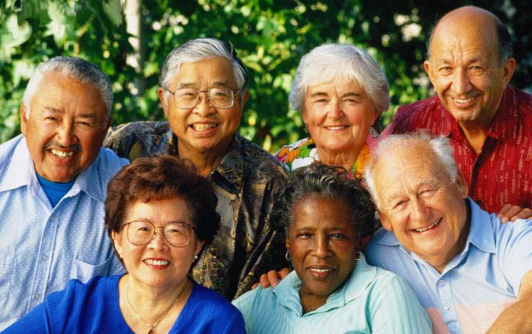
A Community for a Lifetime A Senior Agenda
Montgomery County will be a community for a lifetime,
a place for older adults to live safe, healthy and vital lives.
Adopted by the Montgomery County Council - December 2012

Slide 2
Commitment to Older Adults
Montgomery County will have a policy against ageism including age stereotyping.
Older adults are a valuable economic, cultural and social resource and will be included in all County planning activities at the Executive and Council levels.
Planning related to older adults will include consideration of diversity, inclusiveness and intergenerational elements.
Demographic data about older adults will be maintained, analyzed and incorporated into planning.
Resource information relevant to older adults will be distributed and accessible.
The County will have a plan to address options for aging in place and alternatives.
The County will promote public-private partnerships that contribute to implementation of this Agenda.

Slide 3
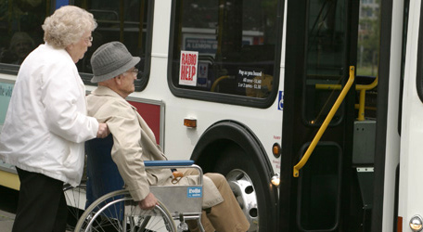
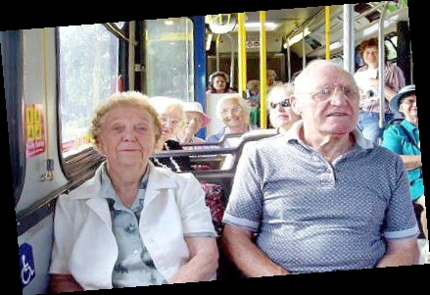
Transportation Vision: Montgomery County will have public and private transportation and mobility systems that enable older adults to go where they want to go, when they want to go and how they want to get there
Affordable senior transportation will be a priority.
Planning will include in-neighborhood options to make transportation accessible and to make affordable escorted transportation available.
Planning will encompass both the needs and safety of pedestrians and those who do not drive.
Transportation planning will include a focus on the needs of older adults as they become less able to drive.

Slide 4
Housing Vision: Montgomery County will promote choices of dwelling types so that as the needs and preferences of older adults change, they can age in place, downsize, choose rental or ownership or find housing with the appropriate level of supportive services without having to leave the community.
Affordable senior housing will be promoted and made available.
Housing options and alternatives will be part of County planning efforts.
Visitable and livable options will be included in County planning.
New and existing construction and redevelopment will consider the needs of both current and prospective older residents.
The County will assist and encourage efforts to create supportive communities such as villages, co-housing and other options.
Redevelopment planning will encourage walkable communities.
Planning efforts will include public-private partnerships as an option to providing housing suitable for older adults.

Slide 5
Socialization and Leisure Vision: Montgomery County will encourage and support vital living of older adults by providing opportunities for physical, mental and social interaction.
Recreation programs will facilitate socialization and other activities that integrate health and wellness.
Recreation programs will be available and easily accessible to older adults throughout the County, particularly in areas where there are no senior centers.
Lifelong learning opportunities will be available.
Libraries will be a location of activities and resources for older adults.
Active efforts will be made to engage older adults as volunteers.

Slide 6
Health and Wellness Vision: Montgomery County will expand public health and prevention programs that promote physical, mental, social and environmental health for older adults.
Medical care for older adults will be available, accessible and affordable.
Healthcare providers will be encouraged to accept private and public health insurance including Medicare and Medicaid.
Direct services and educational programs to plan for serious illness and to manage chronic diseases including promotion of self-management programs will be a priority.
Access to hearing and dental care will be available.

Slide 7
Health and Wellness cont. Vision: Montgomery County will expand public health and prevention programs that promote physical, mental, social and environmental health for older adults.
Nutrition support including education and meals will be provided.
Specialized mental health care will be available as an integral part of the health services delivery system.
Caregiver support will be a priority.
Services to address cognitive impairment will be available, accessible and affordable for affected older adults and their families and caregivers.

Slide 8
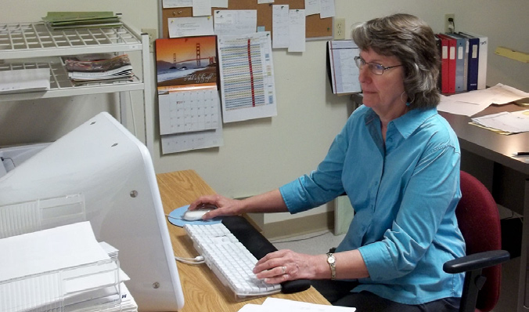
Employment Vision: Montgomery County will recognize the extent and value of the contribution of older adults to the economy.
The County will encourage County agencies and private companies to offer employment opportunities as older adults transition to retirement.
The County will encourage job fairs, partnerships, and forums to help older adults prepare themselves to continue in or reenter the workforce and find jobs.
The County will provide information that promotes the value of older workers.

Slide 9
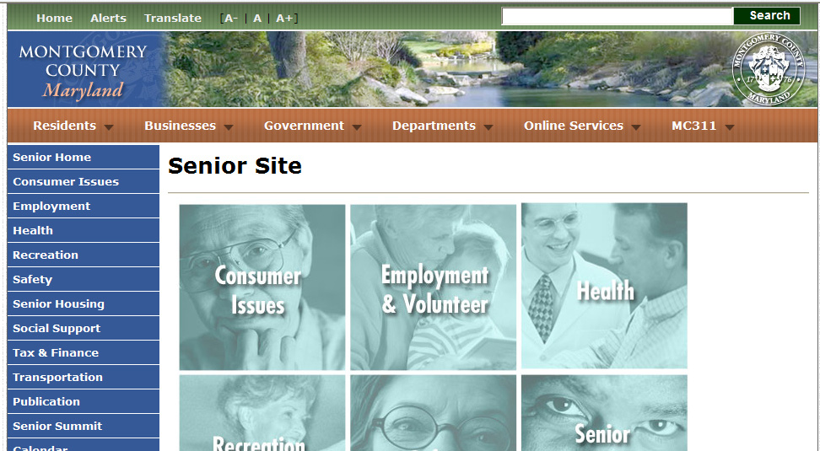
Communications Vision: Montgomery County will distribute and publicize recognizable, understandable, timely and accessible information on County and public resources and services for older adults.
Information will be understandable and accessible by older adults and their caregivers in diverse ethnic population groups
Information will clearly state who is eligible for services at no cost and who is eligible at specified costs.
Information for older adults will be branded uniformly for consistency and recognizable identification
The County will use and publicize multiple media to disseminate information relevant to older adults, including social media, its regularly updated website and a 24/7 information resource line.

Slide 10
Security and Safety Vision: Montgomery County will provide physical, financial and technological protection and safety for older adults.
The County will expand its police and fire safety programs targeted toward older adults.
The County will educate both older adults and their caregivers about the potential for financial crimes, including telephone and computer scams.
The County’s Ombudsman Program will increase its monitoring of the safety of group homes and assisted living facilities.
The County will work to assure legal protection from financial exploitation of older adults.

Slide 11
Steps to a Community for a Lifetime
Find and work with County leaders who care.
Reach out for allies and activists.
Make your case for a Community for a Lifetime.
Decide your priority needs to draft a plan.
Keep at it – persistence pays off!

Slide 12
For more information, visit the
Montgomery County Senior Website:
www.montgomerycountymd.gov/senior
or call the Seniors Resource Line:
240-777-3000 or 311.
For information on the Montgomery County
Commission on Aging:
www.montgomerycountymd.gov/coa

Slide 13
Montgomery County Senior Agenda – A Chronology A Community for a Lifetime
2007-2008: Growing Senior Population – County Executive held Summit, formed “Senior SubCabinet” of Department Directors
2009: Commission on Aging (COA) placed priority on Aging in Place/Community
2010: COA issued “Call to Action”
Called for Senior Agenda to plan and address needs
Called for senior transportation plan
Called for seat at table of Senior Subcabinet
2010: COA drafted sample Community for a Lifetime legislation
2011: COA drafted Senior Agenda for a Community for a Lifetime
2011-2012: COA met with County leaders; sought allies on Senior Agenda; aligned budget/action proposals with Senior Agenda
2012 (May): County Executive endorsed Senior Agenda; requested Resolution from County Council
2012 (Nov.) County Council held hearing; drafted Resolution in support of Senior Agenda
2012 (Dec. 4) County Council unanimously approved Senior Agenda Resolution – later approved several COA budget requests

